Slide 1
Identifying and Mitigating Security Risks
What Is Security?
Identify Security Risks
Security Tradeoffs
Mitigate Security Risks

Slide 2
What Is Security?
Topic A

Slide 3






Security and Emerging Technologies
Building secure technologies requires their creators to strive to avoid causing harm.
Non-Intentional Harm
Intentional Harm

Slide 4





Is Security a Good Thing?
Malicious actors might use secure systems to oppress others or to harm them
Personal Security is an important ethical value
Instrumental Security is about the security of systems
Physical security
Safety from injuries
Psychological security
Safety from stress
Confidentiality
Integrity
Availability

Slide 5

The Principle of No Harm
People should be free, unless they cause harm to others
Preventing harm to others is what security is about
In practice: Take reasonable steps to minimize risks of harm

Slide 6


Bad Actors
Motives
Actor Types
Financial gain
Political gain
Espionage
Recognition/Revenge
Entertainment
Script Kiddies
Professional hackers
Cyber terrorists
State-sponsored hackers
Hacktivists
Ethical hackers: Compromise systems to disclose vulnerabilities to stakeholders

Slide 7
Activity: Discussing the No Harm Principle
Scenario: General discussion.
How safe do driverless cars need to be to satisfy the no-harm principle?
Consider the RudiBrace example. Imagine that bad actors are trying to access the RudiBrace to harm the users. Discuss what types of bad actors might want to attack RudiBrace, and what reasons would motivate them.

Slide 8
Identify Security Risks
Topic B

Slide 9


Sources of Security Risks
Human mistakes
Technical failures
Natural disasters
Malicious attacks

Slide 10
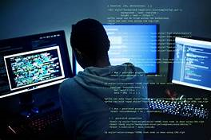
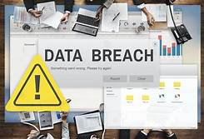
Cyber Attacks
Malware: Viruses, worms, trojan horses, spyware.
Denial of Service (DoS): Preventing use of service.
Zero-day exploits: Attack using unknown system vulnerability.
War driving: Searching for Wi-Fi signals and attacking them.
Passive wiretapping: An attacker intercepts information on your organization’s network.
SQL injection: The queries to one of your organization’s SQL databases are interfered with.

Slide 11
AI-Specific Cyber Attacks
Types of cyber attacks aimed at AI systems:
Evasion: Modifying AI data to make a deployed solution miss its aim.
Poisoning: Contaminating AI training data to influence model performance.
Introducing malicious input into AI training models can be easy.
Modern AI systems are often trained by using input from public sources on the Internet.
Challenging to detect and mitigate.

Slide 12
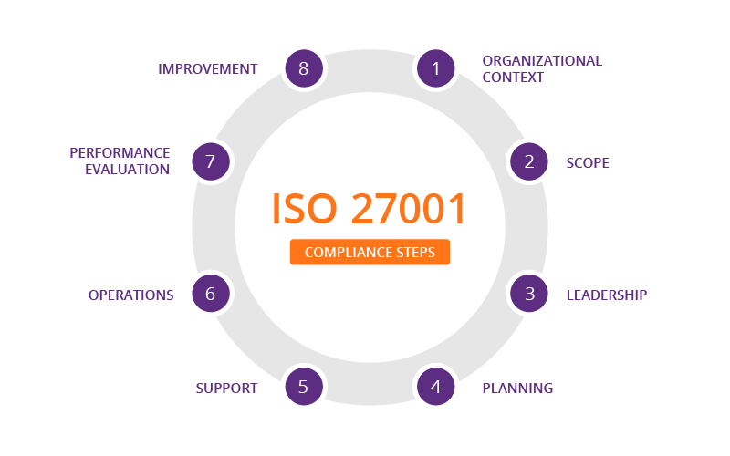


Regulations and Standards
27001: Best practice recommendations for information security management
27002: Code of practice for information security controls
27017: Security standard for cloud services

Slide 13


Risk Libraries
Risk libraries are databases with reusable use cases.
Threats
Weaknesses
Countermeasures
Use Case
Threat model

Slide 14


Security Risk Identification
Conducting a risk assessment:
Probability that risk will materialize
Estimation of impact ($)
Some ethical challenges:
Do not lose sight of nuances of ethical decision making
Not all risk impacts can be easily translated into monetary values

Slide 15







Risk Roles (Slide 1 of 2)
Three ways of involvement in risk:
Being exposed to the risk
Beneficiary
Decision Maker
Benefiting from taking the risk
Making the risky decision
Risk-Exposed

Slide 16

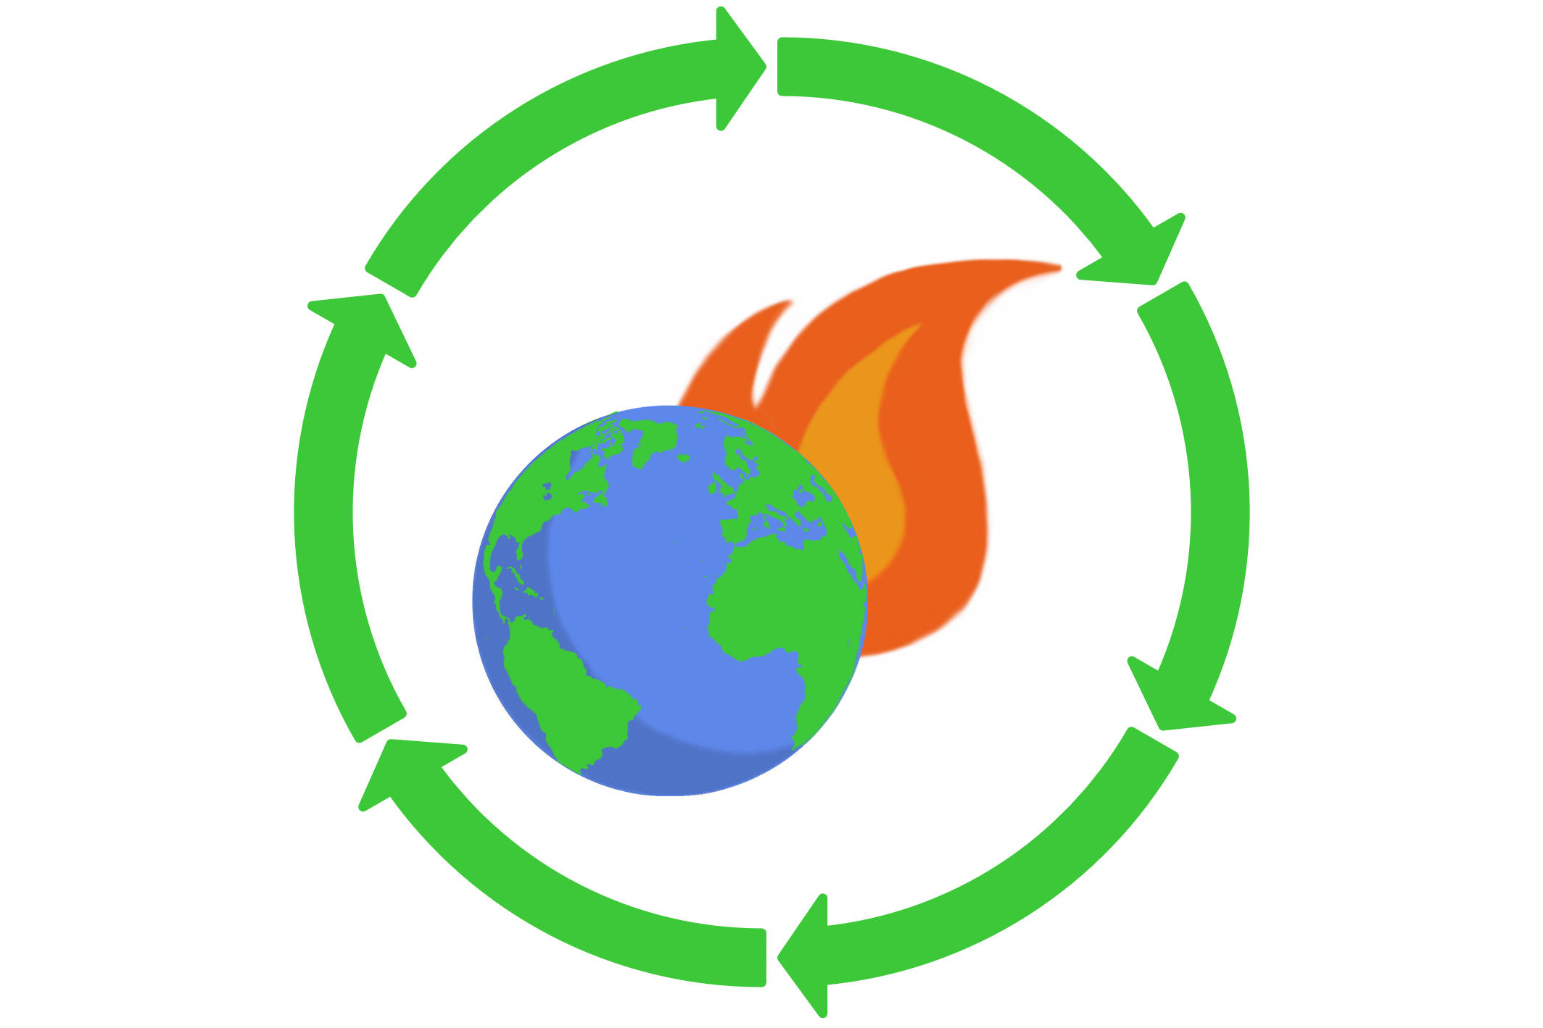


Risk Roles (Slide 2 of 2)
Four types of risk positions:
Beneficiary and decision maker
Only exposed to risk
Beneficiary and risk exposed
Beneficiary only

Slide 17
Security Risk Analysis and Ethical Rights
Risk roles do not affect the gravity or magnitude of risk.
From a favorable risk position, be sure to consider other risk roles and how they are affected.
Consumption vs. climate change
Now vs. future generations
Consider the rights of all risk roles as you analyze risk.

Slide 18
Activity: Identifying Security Risks
Scenario: Consider the RudiBrace product, or a product you are working on in your own workplace.
List at least one security risk associated with the product and the risk roles that your organization has with respect to these risks.
Are there any groups with respect to these risks that are in problematic risk roles?

Slide 19
Security Tradeoffs
Topic C

Slide 20
Potential Security Conflicts
Privacy
Fairness
Security
Account-
ability
Environ-ment

Slide 21


Privacy Tradeoffs
Increase privacy by securing personal data
Support national security by gaining access to personal data
Vs.

Slide 22

Accountability Tradeoffs
Keeping information confidential to increase security
Having access to sensitive information to increase accountability

Slide 23

Fairness Tradeoffs
Increasing system security by limiting access
Lighten burden for vulnerable, high risk groups

Slide 24
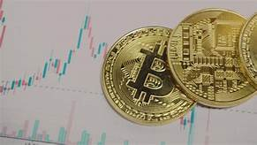
Environmental Tradeoffs
More computation-ally intensive security measures
Lower energy use of data-driven applications

Slide 25
Activity: Identifying Security Tradeoffs
Scenario: Consider the RudiBrace product, or a product you are working on in your own workplace.
Consider at least one security risk associated with the product and ways of addressing the security risk.
Which tradeoffs with privacy, accountability, fairness, or the environment do these strategies create?

Slide 26
Mitigate Security Risks
Topic D

Slide 27
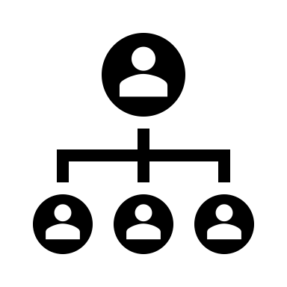


Methods for Mitigating Security Risks
Making organization more secure
Securing Data in Storage and Transit
Analyzing and Mitigating Security Risks

Slide 28

Establishment of Baselines for System Behavior
Establish Normal System Behavior
Common metrics
Bandwidth consumption
Software versions
Upload and download times
Task completion times
User access and behavior
Key performance indicators

Slide 29



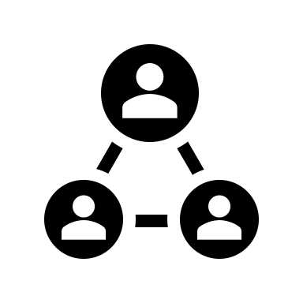
Designation of Rapid Response Teams
Cyber Security Incidence Response Team (CSIRT)
Investigators: Identify causes of abnormal behavior
Security experts: Fix systems
Help Desk staff: Assist affected users
Crisis communication experts: Manage communications
Managers: Coordinate overall response

Slide 30


Protection of Stored Data
Objectives: CIA
Confidentiality
Integrity
Availability
How to achieve:
Encryption
Access control
Physical barriers
Data destruction

Slide 31


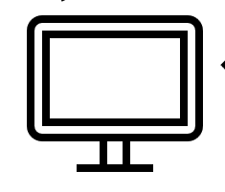

Protection of Data in Transit
Network protocols:
Link encryption: SSL TLS
End-to-end encryption: SSH
Digital signatures
DDOS mitigation protection

Slide 32





Threat Modeling and Analysis
Attacker profile
Threat library
System simulation
Vulnerability Scoring
Cognitive Security

Slide 33



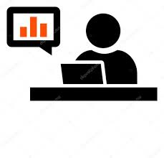
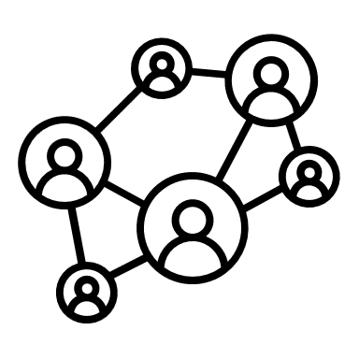
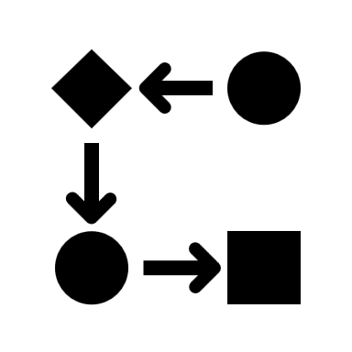

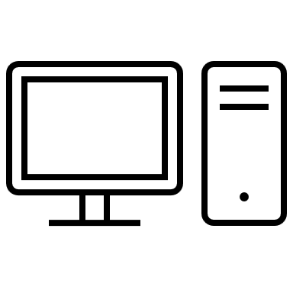

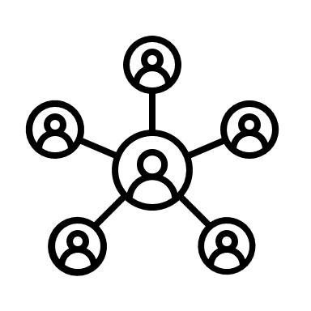


Breach and Attack Simulations
Visualization, Reporting, and Output
Firewall
Threat Intel
SIEM Alerts
XM Cyber Platform Server and sensor (up-to-date)
Network Data
Network Data
Flow Data
Proxy/Wi-Fi Data
Attack campaigns using different methods and payloads
Endpoint/Identity Data
Endpoint Data
User Data/AD
Database Data
For Remediation

Slide 34
Activity: Identifying Security Risk Mitigation Techniques
Scenario: Consider the RudiBrace product, or a product you are working on in your own workplace.
For the RudiBrace or your own product, can you describe some baselines for normal system behavior that can be used to detect security problems?
For a security risk associated with the product, list some techniques that can help to mitigate the security risk.

Slide 35
What do you think is the primary security risk for emerging technology at your workplace?
What types of tactics do you think are best suited to mitigating this risk?

